Slide 1





PSLF Basics
120 qualifying payments…
While working for a qualifying employer
Forgiven amount is not taxable income
…on Direct Loans…
…when applying for and receiving PSLF

Slide 2



LIMITED PSLF WAIVER
On Oct. 6, 2021, the U.S. Department of Education (ED) announced a change to Public Service Loan Forgiveness (PSLF) program rules for a limited time.
Borrowers may receive credit for past periods of repayment that would otherwise not qualify for PSLF. Under the new, temporary rules, any prior period of repayment will count as a qualifying payment, regardless of loan program, repayment plan, or whether the payment was made in full or on time. You continue to need qualifying employment.
This change applies to student loan borrowers with Direct Loans, those who have already consolidated into the Direct Loan Program, and those who consolidate into the Direct Loan Program by Oct. 31, 2022.
17

Slide 3
Limited Pslf waiver
The limited pslf waiver has impacted Hundreds of thousands of borrowers
To date, the Department has approved over $10 billion in forgiveness for more than 175,000 borrowers through the Limited PSLF Waiver.
The waiver has brought another 1.1 million borrowers closer to forgiveness, with the average borrower picking up a year’s worth of credit.
More than a quarter of a million borrowers got 2 years or more of additional credit toward forgiveness.
These numbers will all continue to grow as the Department continues to process paperwork and review files.
Notes:
Updated as of 5-20-22

Slide 4

Limited PSLF Waiver: Through 10/31/22
Payments made prior to consolidation are now eligible
No matter the loan program (DL, FFEL, Perkins)
No matter the repayment plan
No matter the loan type (with the exception of Parent PLUS)

Slide 5

Limited PSLF Waiver: Through 10/31/22
Payments made prior to consolidation are now eligible
No matter the loan program (DL, FFEL, Perkins)
No matter the repayment plan
No matter the loan type (with the exception of Parent PLUS)
Must have been employed
full-time and
for a qualifying employer
when prior payments were made
Employment requirements still apply

Slide 6

Limited PSLF Waiver: Through 10/31/22
Payments made prior to consolidation are now eligible
No matter the loan program (DL, FFEL, Perkins)
No matter the repayment plan
No matter the loan type (with the exception of Parent PLUS)
Must have been employed
full-time and
for a qualifying employer
when prior payments were made
Employment requirements still apply
Borrowers who still have FFEL and Perkins Loans can only get credit for past payments if they consolidate into DL and file PSLF Forms for prior employment before Oct. 31, 2022. After Oct. 31, 2022, normal PSLF/TEPSLF requirements will apply.
Borrowers must act now

Slide 7

Note on Parent PLUS Loans
Parent PLUS Loans are not excluded from PSLF.
However, Parent PLUS Loans are not eligible for all income-driven repayment plans. They’re only eligible for Income Contingent Repayment (ICR).
Parent PLUS borrowers can consolidate their debt to access the ICR plan and thus, PSLF.
Parent Plus borrowers should use the Loan Simulator to compare how an ICR payment on a consolidation loan would compare to a graduated or extended payment they may currently be making.
Notes:
Updated 5-17-22

Slide 8
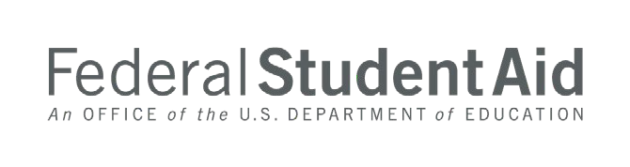

PSLF BONUS: IDR PAYMENT COUNT ADJUSTMENT
The Income Driven Repayment (IDR) Account Adjustment, announced on April 19, 2022, will impact PSLF borrowers:
Borrowers that have 12 or more months of consecutive forbearance or 36 or more months of cumulative forbearance, will receive PSLF credit for those periods of time if qualifying employment has been certified for the same period
These changes will be applied automatically. But, if a borrower believes they might benefit, they should be sure to submit a PSLF Form to certify all periods of qualifying employment.

Slide 9
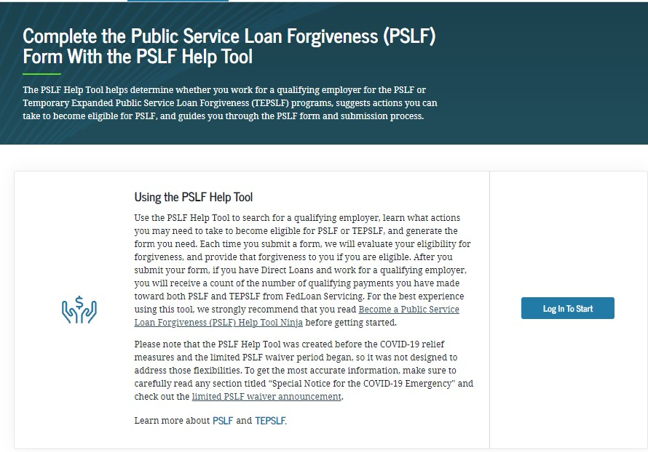
PSLF LANDING PAGE
URL: StudentAid.gov/PSLF

Slide 10




PSLF INFORMATION AND RESOURCES
LIMITED PSLF WAIVER
PSLF HELP TOOL
StudentAid.gov/pslfwaiver
StudentAid.gov/pslf
WHAT TO DO WITH YOUR PSLF FORM
GENERAL PSLF INFORMATION
StudentAid.gov/publicservice
Beginning July 1, submit your PSLF forms to MOHELA:
Make sure to review the FAQs!
Beginning July 1, 2022, all new PSLF form submissions go to MOHELA.
Mail to: U.S. Department of Education, MOHELA, 633 Spirit Drive, Chesterfield, MO 63005-1243.
Fax to: 866-222-7060.
Upload to: mohela.com/uploadDocument
if MOHELA is already your servicer.
46

